Slide 1


Principles of Data Science
מבוא למדעי הנתונים – תשפ"ב, סמסטר א'
המחלקה להנדסת תוכנה
המכללה האקדמית להנדסה ע"ש סמי שמעון

Slide 2
Welcome – General Information
Lectures:
Aviad Elyashar – aviade@sce.ac.il
Course’s website – Moodle

Slide 3
General Information
Course:
40% - Test
60% - Assignments
Assignments:
3 assignments
Includes both theoretically and practically tasks
Assignments will be submitted in pairs.
נוכחות חובה

Slide 4
Course goals
During this course, you will learn to:
How to collect data
How to create data from various sources
How to manipulate data
How to handle with massive datasets
How to identify patterns in the data

Slide 5
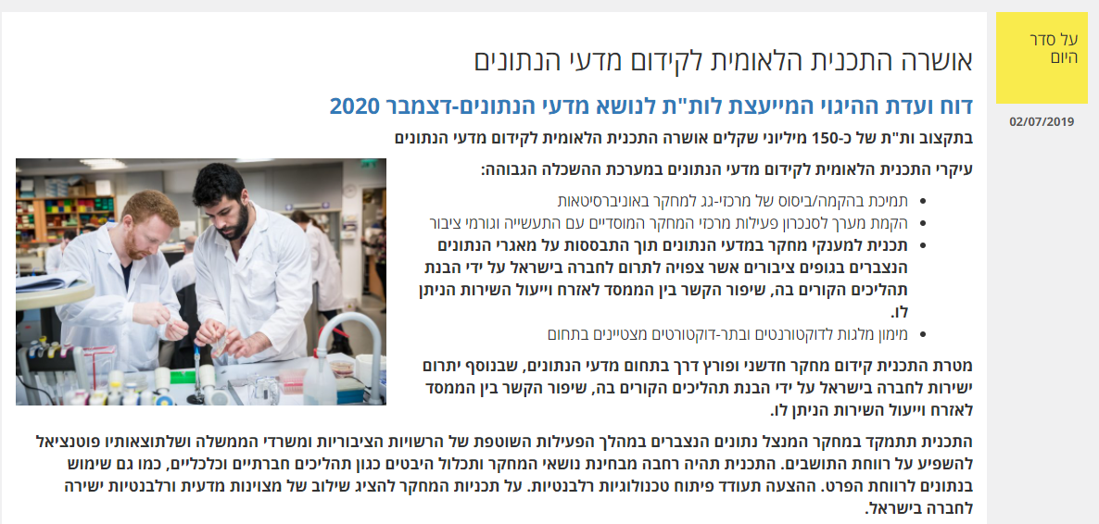

Slide 6
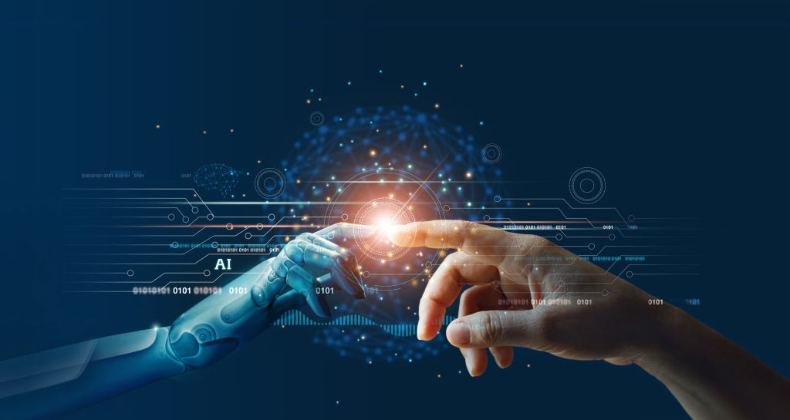
The AI Revolution
Today, we has witnessed the AI revolution.

Slide 7
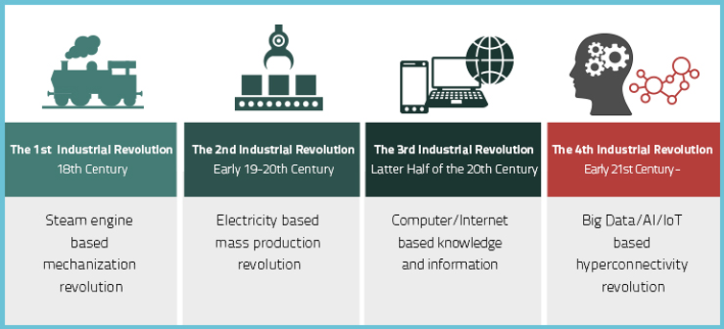
The AI Revolution
Data serves as the fuel that powers AI
Notes:
חוקרים שונים ממשיכים ומגדירים את המהפכה התעשייתית כתקופה מתמשכת שלא הסתיימה, ושבמרכזה ארבעה גלים:
המהפכה הראשונה - שהחלה באמצע המאה ה-18 עד אמצע המאה ה-19, ובמרכזה העיור, המצאת הקיטור, תעשיות הברזל והטקסטיל, מכונות הייצור ועוד.
המהפכה השנייה - שהחלה בסוף המאה ה-19 ונמשכה עד מלחמת העולם הראשונה, ובמרכזה השימוש בחשמל לייצור ההמוני, המצאת הטלפון והנורות, מנוע הבעירה הפנימית ועוד.
המהפכה השלישית - שהחלה בשנות ה-80 של המאה ה-20, ובמרכזה תחילת הדיגיטציה, המחשב האישי, האינטרנט, ה-ICT ועוד.
המהפכה הרביעית - שהחלה בעשור השני של המאה ה-21, ובמרכזה רובוטיקה, בינה מלאכותית, ביג דאטה, ננוטכנולוגיה ועוד.

Slide 8
Pillars of Science
Computational
Science
Data-Intensive
Science
Theory
Experimentation
https://cacm.acm.org/magazines/2010/9/98038-science-has-only-two-legs/fulltext
Notes:
computational science now constitutes the 'third pillar' of scientific inquiry, enabling researchers to build and test models of complex phenomena."
Examples such as multi-century climate shifts, multidimensional flight stresses on aircraft, and stellar explosions.
The fourth leg refers to the usage of advanced computing capabilities to manipulate and explore massive datasets.
For example, the decoding of the human genome in 2001.

Slide 9

Reasons for the AI Revolution
As technology advanced and commercial opportunities fueled reciprocal growth, the volume of Internet traffic was increased, doubling every 18 months.

Slide 10

Reasons for the AI Revolution
In the 00s, Internet becomes more of a central issue in our lives.
Today, there are billions of users all over the world who use the Internet.
Many of them use it on a daily basis.
Nowadays, people can
read articles,
write talkbacks,
buy goods,
play games,
watch movies,
schedule appointments,
pay bills, etc. by using the Internet.

Slide 11
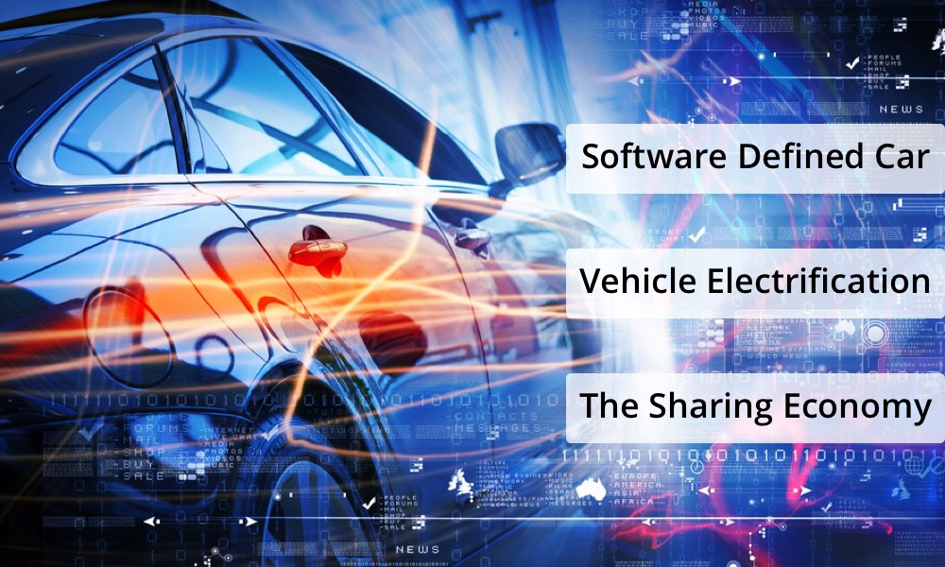
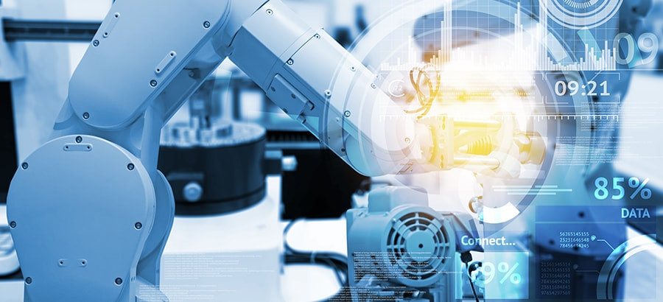
Reasons for the AI Revolution
Digitalization of many domains:
Vehicles (e.g., cars)
Organizations
Corporates
Schools, universities, colleges
Factories
Networking
Weather Forecasting
Services

Slide 12



Reasons for the AI Revolution
One sector of the Internet that has dominated in the recent decade is the platform of online social networks (OSNs).
Facebook, Twitter, and LinkedIn are all examples of well-known OSNs which encourage Internet users to
create profiles,
find new friendships,
maintain old friendships,
publish posts,
participate in online discourses, etc.

Slide 13

Rising popularity of online social networks

Slide 14
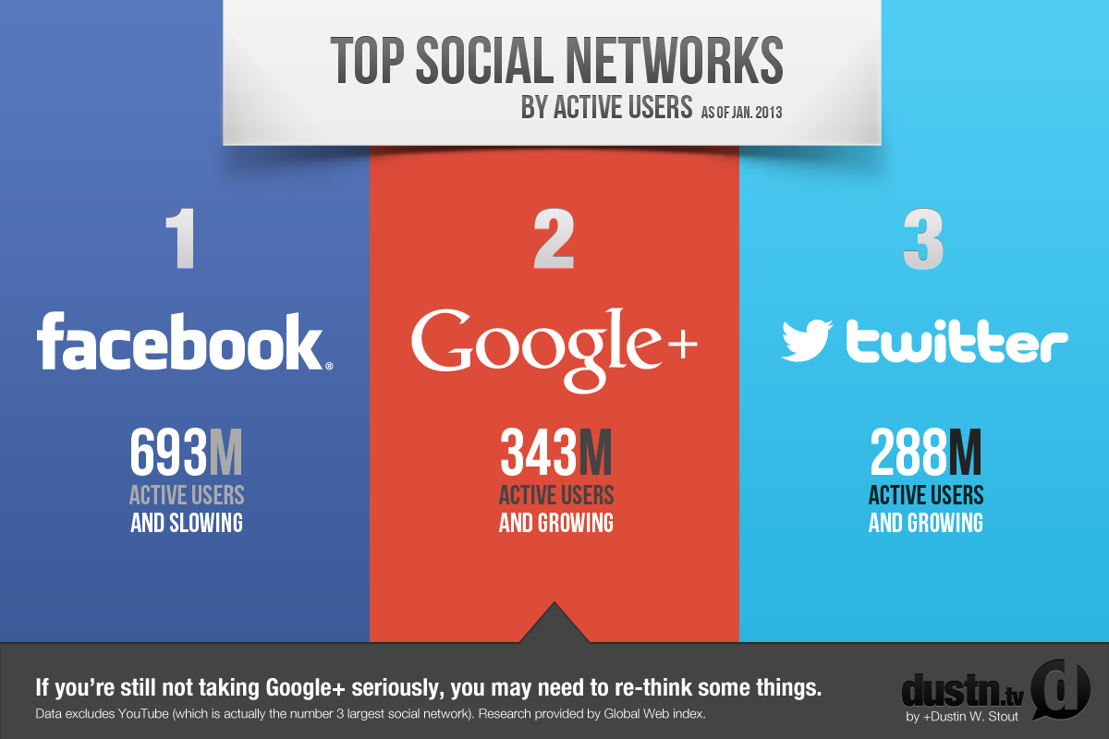
Rising popularity of online social networks

Slide 15




The Power of Data
The most largest retailer, has no inventory.
The world’s largest accommodation provider, owns no real estate.
The world’s most popular media owner, creates no content.
The world’s largest taxi company, owns no vehicles.

Slide 16
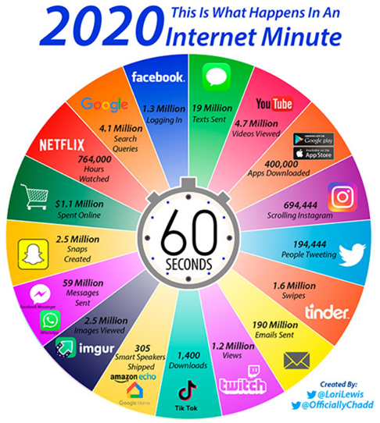
Data is the Fuel that Powers ML & AI
World Economic Forum

Slide 17
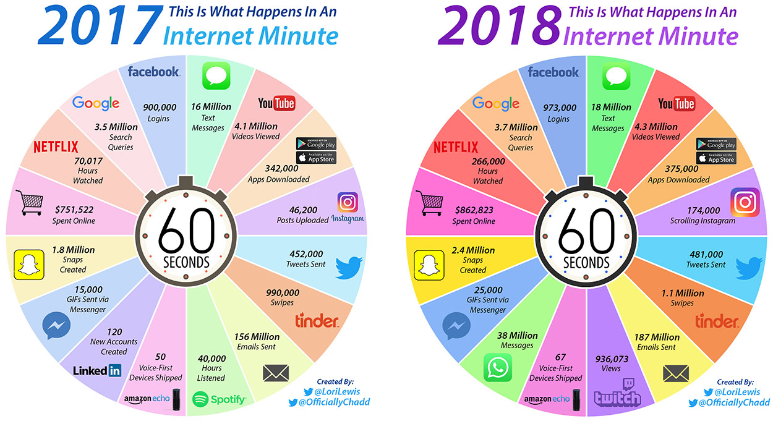
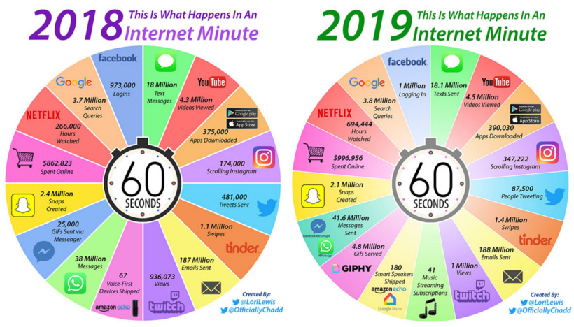
Big Data Keeps Getting Bigger

Slide 18
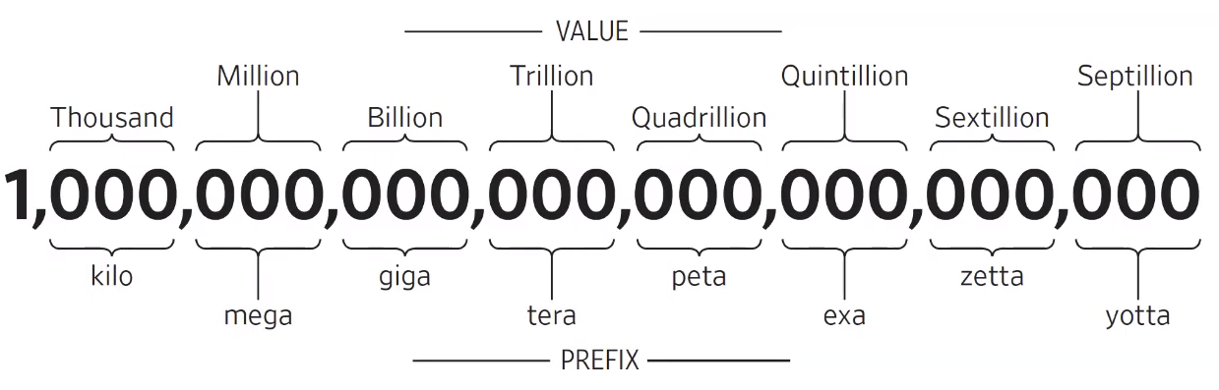
Big Data Keeps Getting Bigger

Slide 19
Reasons for the AI Revolution
The exponential growth pf data is generated every day.
https://www.visualcapitalist.com/wp-content/uploads/2019/04/data-generated-each-day-full.html

Slide 20
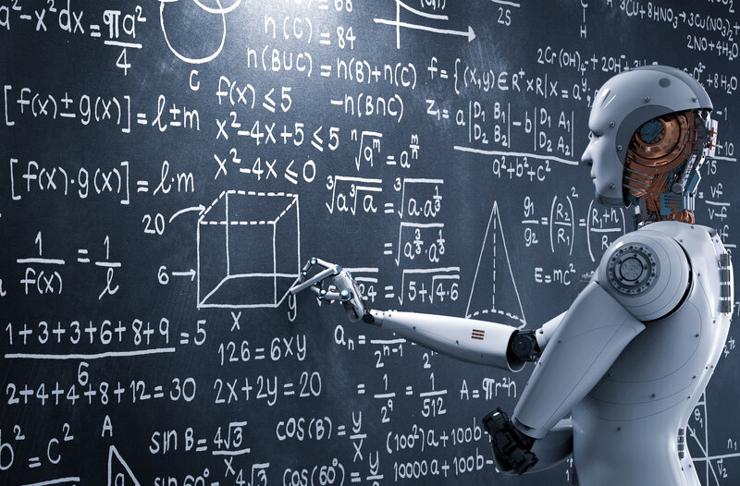
Benefits of artificial intelligence
New inventions:
AI is powering many inventions in almost every domain which will help humans solve the majority of complex problems.
Example:
Recently doctors can predict breast cancer in the woman at earlier stages using advanced AI-based technologies.

Slide 21

Benefits of artificial intelligence
Reduction in Human Error
The phrase “human error” was born because humans make mistakes from time to time.
Computers, however, do not make these mistakes if they are programmed properly.
With artificial intelligence, the decisions are taken from the previously gathered information applying a certain set of algorithms.
So errors are reduced and the chance of reaching accuracy with a greater degree of precision is a possibility.
Notes:
https://towardsdatascience.com/advantages-and-disadvantages-of-artificial-intelligence-182a5ef6588c

Slide 22
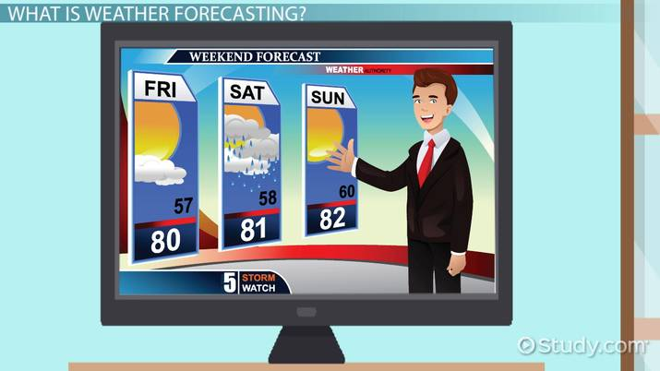
Benefits of artificial intelligence
Reduction in Human Error
For example, In weather forecasting using AI, they have reduced the majority of human error.

Slide 23

Benefits of artificial intelligence
Takes risks instead of humans
This is one of the biggest advantages of artificial intelligence.
We can overcome many risky limitations of humans by developing an AI robot, which in turn can do the risky things for us.

Slide 24
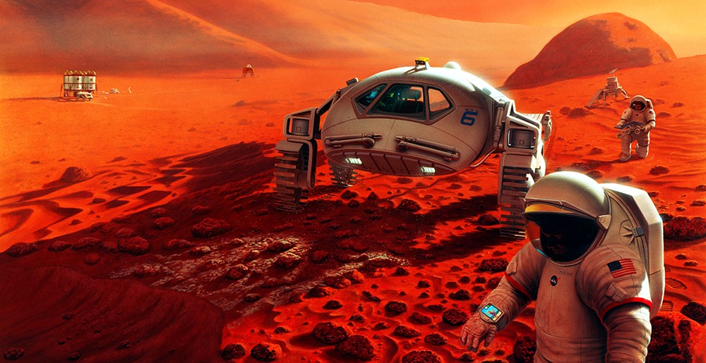



Benefits of artificial intelligence
Takes risks instead of humans
Examples:
going to mars,
defuse a bomb,
explore the deepest parts of oceans,
mining for coal and oil,
it can be used effectively in any kind of natural or man-made disasters.

Slide 25


Benefits of artificial intelligence
Takes risks instead of humans
Example:
Chernobyl nuclear power plant explosion in Ukraine.
At that time there were no AI-powered robots that can help us to minimize the effect of radiation by controlling the fire in early stages, as any human went close to the core was dead in a matter of minutes.
They eventually poured sand and boron from helicopters from a mere distance.

Slide 26

Benefits of artificial intelligence
Available 24x7:
An average human will work for 4–6 hours a day excluding the breaks.
Humans are built in such a way to get some time out for refreshing themselves and get ready for a new day of work and they even have weekly offed to stay intact with their work-life and personal life.
But using AI we can make machines work 24x7 without any breaks and they don’t even get bored, unlike humans.
Example: Educational Institutes and Helpline centers are getting many queries and issues which can be handled effectively using AI.

Slide 27
Benefits of artificial intelligence
Helping in Repetitive Jobs:
In our day-to-day work, we will be performing many repetitive works like sending a thanking mail, verifying certain documents for errors and many more things.
Using artificial intelligence we can productively automate these mundane tasks and can even remove “boring” tasks for humans and free them up to be increasingly creative.

Slide 28
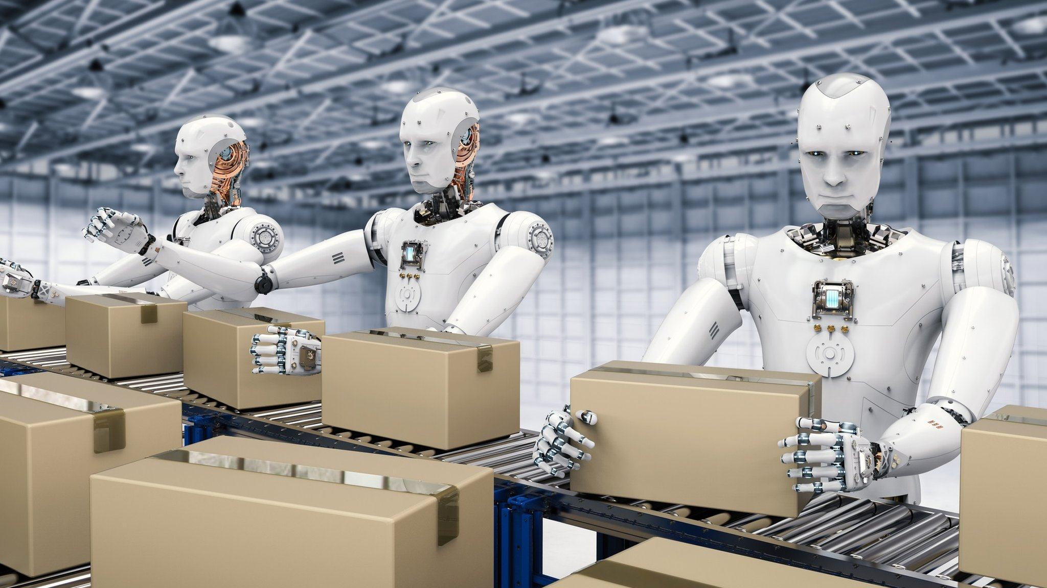
Benefits of artificial intelligence
Helping in Repetitive Jobs:
Example:
In banks, we often see many verifications of documents to get a loan which is a repetitive task for the owner of the bank.
Using AI cognitive automation, the owner can speed up the process of verifying the documents by which both the customers and the owner will be benefited.

Slide 29

Benefits of artificial intelligence
Digital assistance:
Some of the highly advanced organizations use digital assistants to interact with users which saves the need for human resources.
The digital assistants also used in many websites to provide things that users want.
We can chat with them about what we are looking for.
Some chatbots are designed in such a way that it’s become hard to determine that we’re chatting with a chatbot or a human being.
Notes:
Example: Using AI the organizations can set up a Voice bot or Chatbot which can help customers with all their queries. We can see many organizations already started using them on their websites and mobile applications.

Slide 30

Benefits of artificial intelligence
Faster decisions:
Using AI alongside other technologies, we can make machines take decisions faster than a human and carry out actions quicker.
While taking a decision human will analyze many factors both emotionally and practically but AI-powered machine works on what it is programmed and delivers the results in a faster way.

Slide 31



Benefits of artificial intelligence
Daily Applications:
Daily applications, such as Apple’s Siri, Window’s Cortana, Google’s OK Google are frequently used in our daily routine whether it is for searching a location, taking a selfie, making a phone call, replying to a mail and many more.

Slide 32
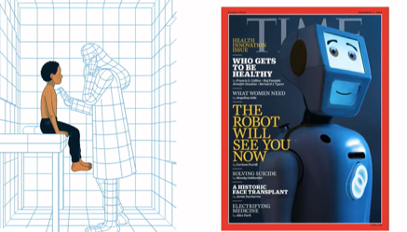
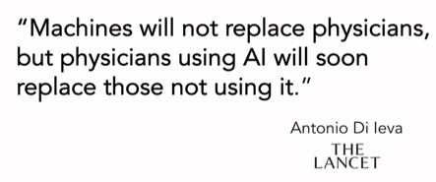

Slide 33


Drawbacks of artificial intelligence
High Costs of Creation:
As AI is updating every day the hardware and software need to get updated with time to meet the latest requirements.
Machines need repairing and maintenance which need plenty of costs.
It’s creation requires huge costs as they are very complex machines.
Notes:
https://towardsdatascience.com/advantages-and-disadvantages-of-artificial-intelligence-182a5ef6588c

Slide 34
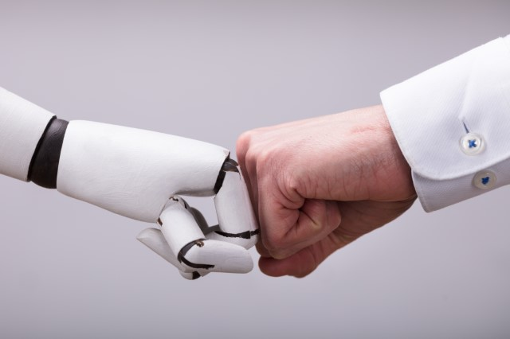
Drawbacks of artificial intelligence
Making Humans Lazy:
AI is making humans lazy with its applications automating the majority of the work.
Humans tend to get addicted to these inventions which can cause a problem to future generations.
Notes:
https://towardsdatascience.com/advantages-and-disadvantages-of-artificial-intelligence-182a5ef6588c

Slide 35
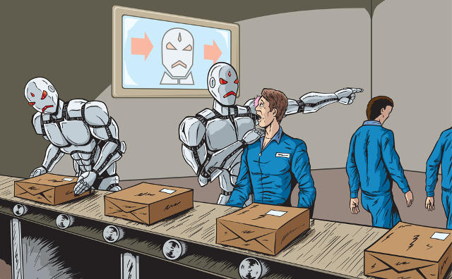
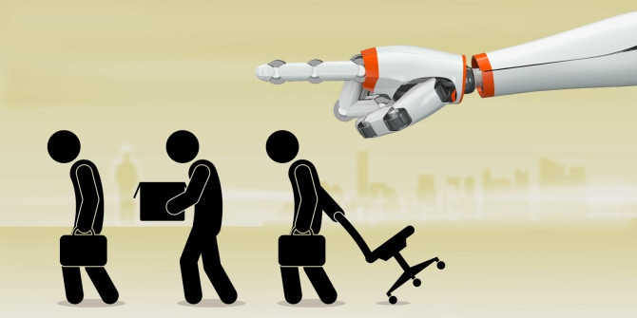
Drawbacks of artificial intelligence
Unemployment:
As AI is replacing the majority of the repetitive tasks and other works with robots, human interference is becoming less which will cause a major problem in the employment standards.
Every organization is looking to replace the minimum qualified individuals with AI robots which can do similar work with more efficiency.
Notes:
https://towardsdatascience.com/advantages-and-disadvantages-of-artificial-intelligence-182a5ef6588c

Slide 36
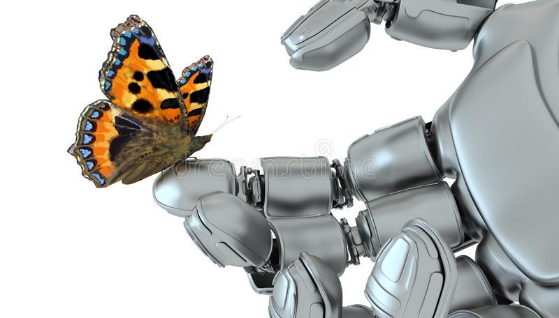
Drawbacks of artificial intelligence
No Emotions:
There is no doubt that machines are much better when it comes to working efficiently, but they cannot replace the human connection that makes the team.
Machines cannot develop a bond with humans which is an essential attribute when comes to team management.
Notes:
https://towardsdatascience.com/advantages-and-disadvantages-of-artificial-intelligence-182a5ef6588c

Slide 37

Drawbacks of artificial intelligence
Lacking Out of Box Thinking:
Machines can perform only those tasks which they are designed or programmed to do, anything out of that they tend to crash or give irrelevant outputs which could be a major backdrop.
Notes:
https://towardsdatascience.com/advantages-and-disadvantages-of-artificial-intelligence-182a5ef6588c

Slide 38
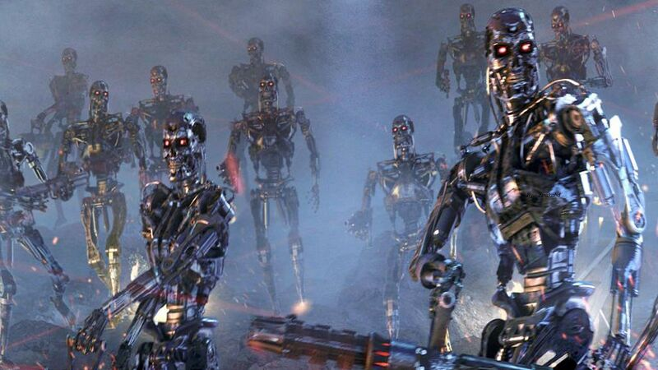
Will machines take over the world?

Slide 39
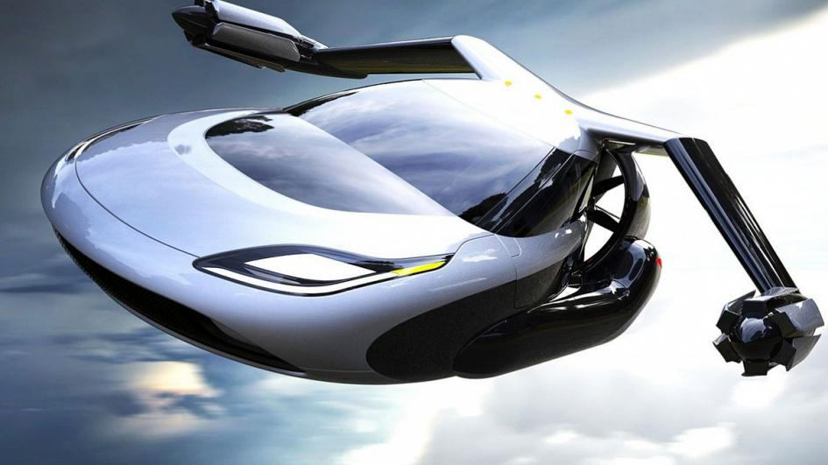

Predictions
At the end of World War 2, it was stated that flying cars were just around the corner and that all energy problems would be solved by fusion energy by the end of the 20th century.
But decades on, we don’t seem much closer to either of those predictions coming true.
Notes:
https://theconversation.com/five-reasons-why-robots-wont-take-over-the-world-94124

Slide 40

Why robots won’t take over the world?
There is still a long way to go before robots will be able to match a number of fundamental human skills.
Notes:
https://theconversation.com/five-reasons-why-robots-wont-take-over-the-world-94124

Slide 41
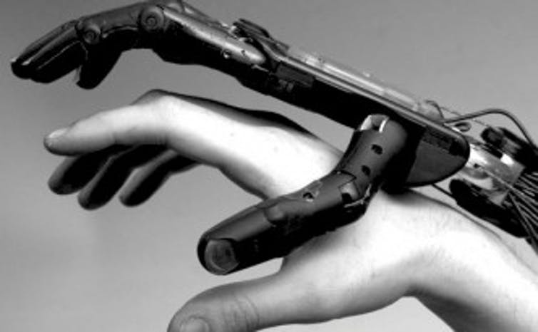
Why robots won’t take over the world?
Human-like hands
Scientists are far from replicating the complexity of human hands.
The hands of robots that are used today in real applications are clumsy.
The more sophisticated hands developed in labs are not robust enough and lack the dexterity of human hands.
Notes:
https://theconversation.com/five-reasons-why-robots-wont-take-over-the-world-94124

Slide 42

Why robots won’t take over the world?
Lack of tactile perception
There is no technical match for the magnificent human and animal skin that encompasses a variety of tactile sensors.
This perception is required for complex manipulation.
Also, the software that processes the input from the sensors in robots is nowhere near as sophisticated as the human brain when it comes to interpretation and reaction to the messages received from the tactile sensors.
Notes:
https://theconversation.com/five-reasons-why-robots-wont-take-over-the-world-94124

Slide 43
Why robots won’t take over the world?
Human and robot interaction
The interaction between humans is built on well-functioning speech and object recognition systems, as well as other sensors, such as smell and taste and tactile sensing.
While there has been significant progress in speech and object recognition, today’s systems can still only be used in rather controlled environments when a high degree of performance is required.
Notes:
https://theconversation.com/five-reasons-why-robots-wont-take-over-the-world-94124

Slide 44
Why robots won’t take over the world?
Human reason
Human reason could decide not to fully develop such robots, because of their potential harm to society.
If, in many decades from now, the technical problems mentioned above are overcome so that complex human-like robots could be built, regulations could still prevent misuse.
Notes:
https://theconversation.com/five-reasons-why-robots-wont-take-over-the-world-94124

Slide 45
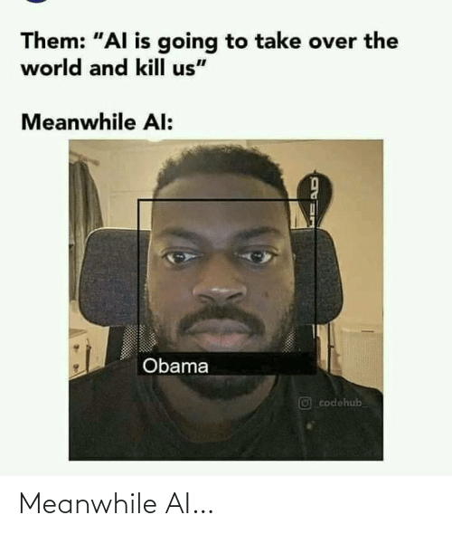
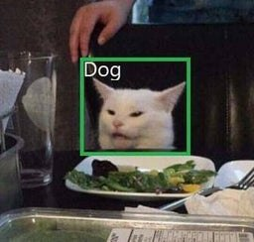
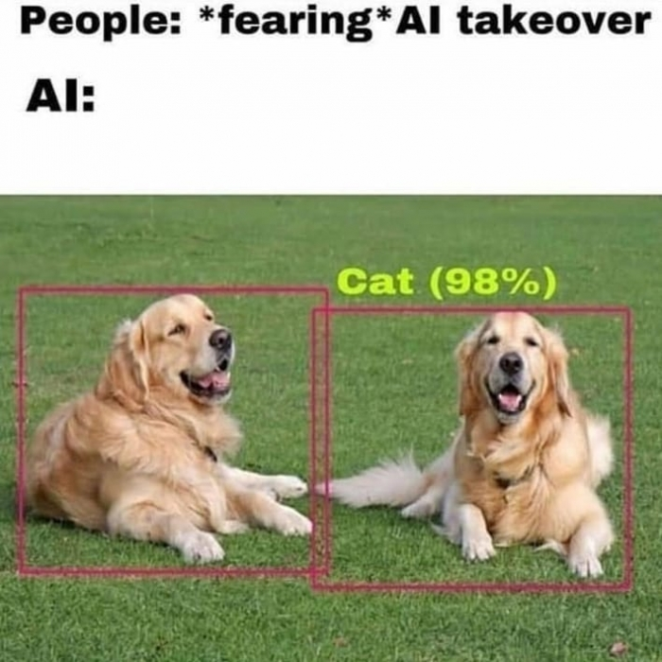
Why robots won’t take over the world?
Notes:
https://www.bitmascot.com/ai-will-create-new-jobs/

Slide 46
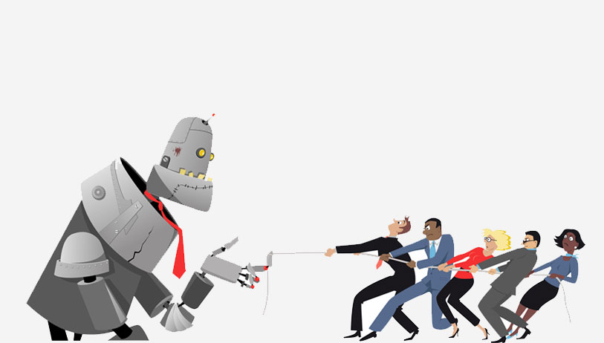
Will machines take our jobs?

Slide 47

Will machines take our jobs?
History shows us that the fear of technology replacing the human workforce is not something new.
During the industrial revolution, the introduction of automated machines in textile mills created a similar fear among people.
But eventually, it caused a boom in the job market.
Notes:
https://www.bitmascot.com/ai-will-create-new-jobs/

Slide 48
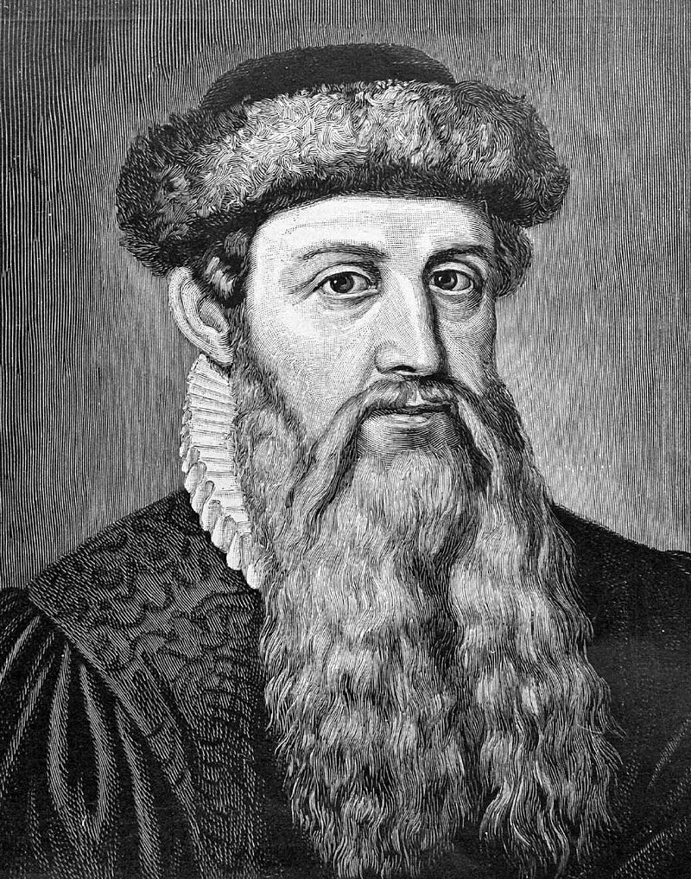

Will machines take our jobs?
When Gutenberg introduced mechanical printing to Europe in the 13th century, scribes went out of business.
But the printing press gave birth to newspapers and led to the large production of books and created new jobs.
Notes:
https://www.bitmascot.com/ai-will-create-new-jobs/

Slide 49
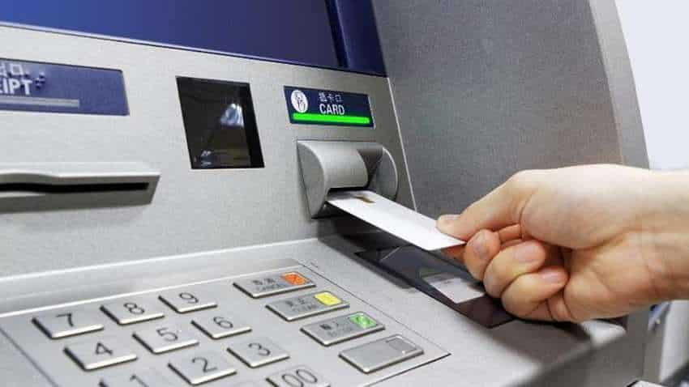
Will machines take our jobs?
In 1985, the US had
60,000 ATMs and
485,000 bank tellers.
In 2002, the number of ATMs reached 352,000, but the number of tellers also increased to 527,000.
In addition to that, ATMs created new jobs for maintenance technicians.
Notes:
https://www.bitmascot.com/ai-will-create-new-jobs/

Slide 50
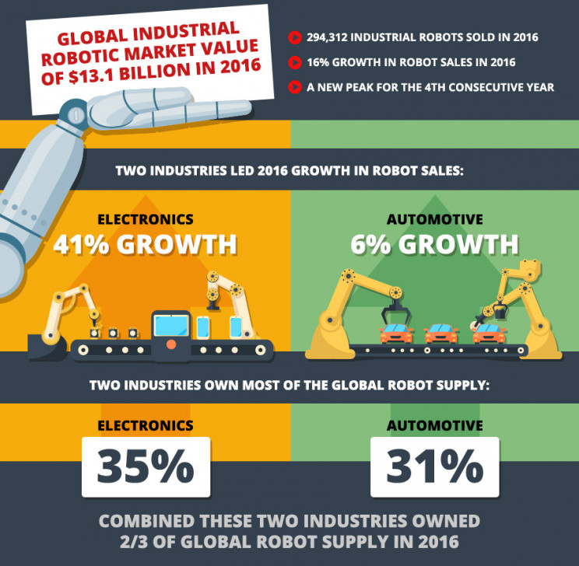
Examples for growth thanks to AI

Slide 51
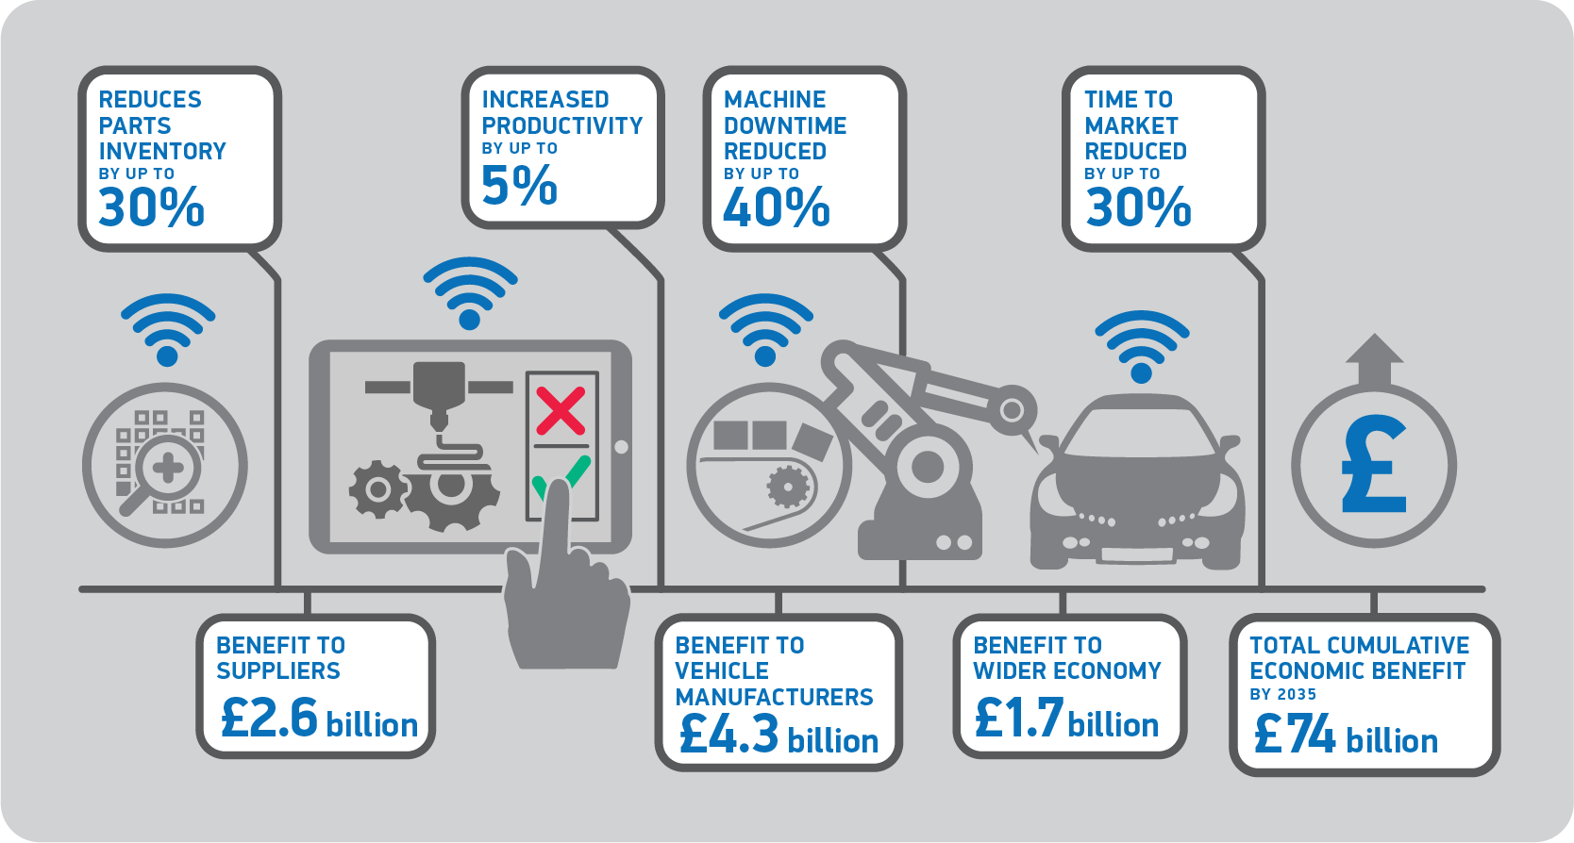
Examples for growth thanks to AI
Car market

Slide 52
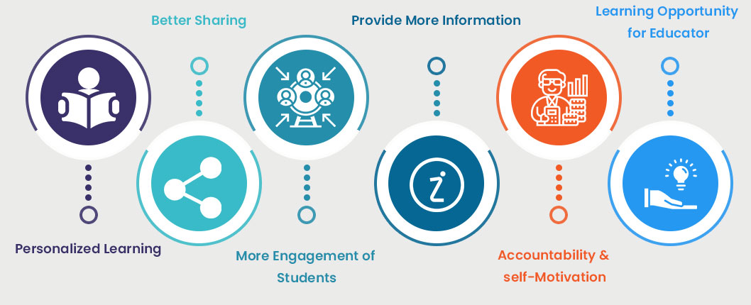
Examples for growth thanks to AI
Notes:
Education

Slide 53

How Netflix built a House of Cards with big data?
The series House of Cards
one survey from Cowen and Company found that 86% of Netflix’s subscribers said they were less likely to cancel their subscription because of the show.
But what’s fascinating is that without seeing a single episode of House of Cards, Netflix committed to two seasons of the show, or 26 episodes, bidding a reported $100 million. That’s $3.8 million per episode.
Notes:
https://www.bitmascot.com/ai-will-create-new-jobs/

Slide 54
How Netflix built a House of Cards with big data?
How did they know it would be such a runaway hit?
The answer is Big Data.
By analyzing viewer data – 30 million “plays”, 4 million ratings, 3 million searches - the company was able to determine that fans of the original House of Cards, which aired in the UK, were also watching movies that starred Kevin Spacey and were directed by David Fincher, who’s one of the show’s executive producers.
Netflix engineered fans’ addiction
Notes:
https://www.bitmascot.com/ai-will-create-new-jobs/

Slide 55
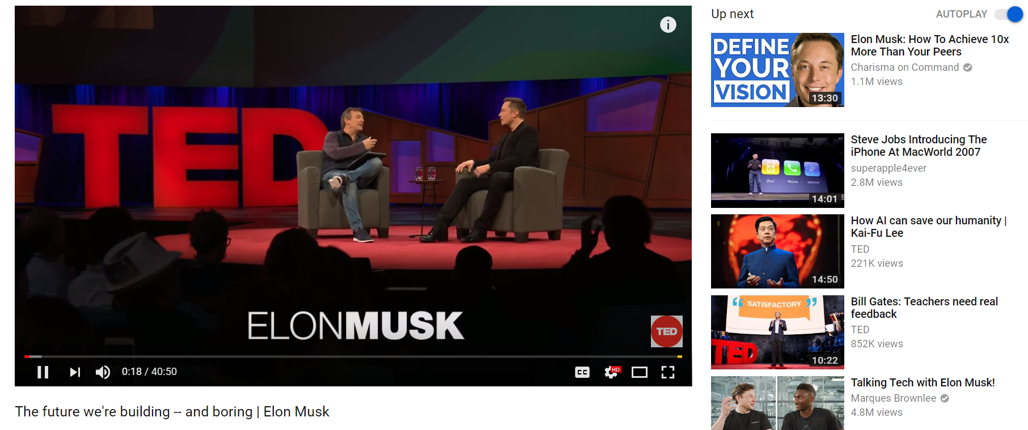
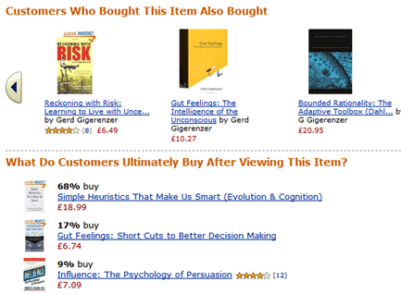
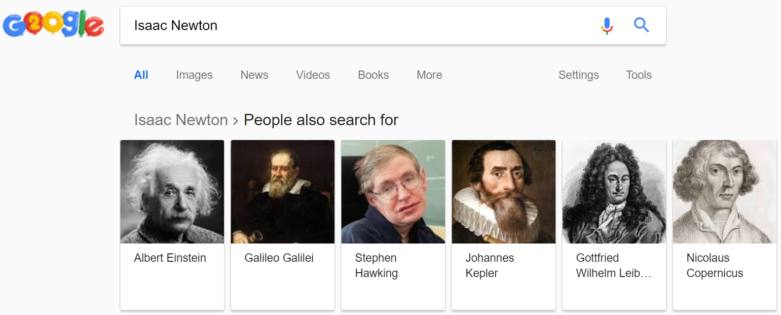
Recommender Systems
A recommender system (RS) helps users that have no sufficient competence or time to evaluate the, potentially overwhelming, number of alternatives offered by a web site.
In their simplest form, RSs recommend to their users personalized and ranked lists of items

Slide 56
The Impact of RecSys
35% of the purchases on Amazon are the result of their recommender system, according to McKinsey.
During the Chinese global shopping festival of November 11, 2016, Alibaba achieved growth of up to 20% of their conversion rate using personalized landing pages, according to Alizila.
Recommendations are responsible for 70% of the time people spend watching videos on YouTube.
75% of what people are watching on Netflix comes from recommendations, according to McKinsey
https://tryolabs.com/blog/introduction-to-recommender-systems/

Slide 57
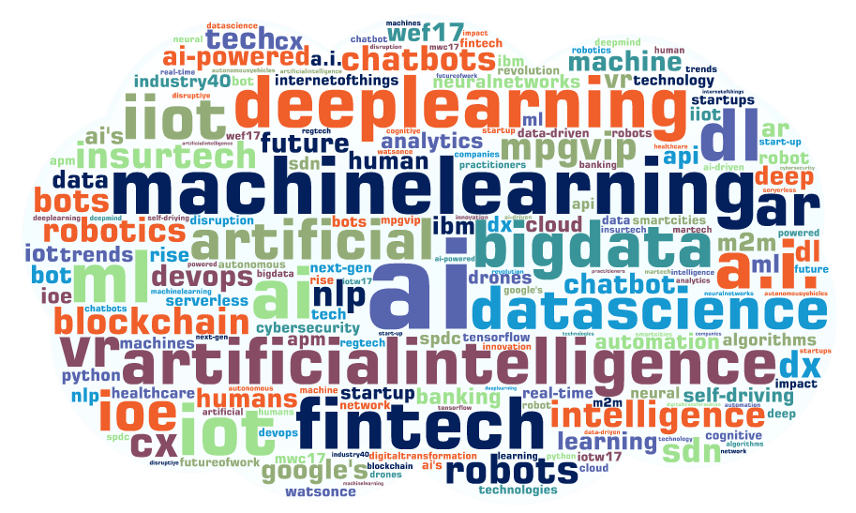
Buzzword explanation
What is the difference between AI? ML? DL? Data Science? Big Data?

Slide 58
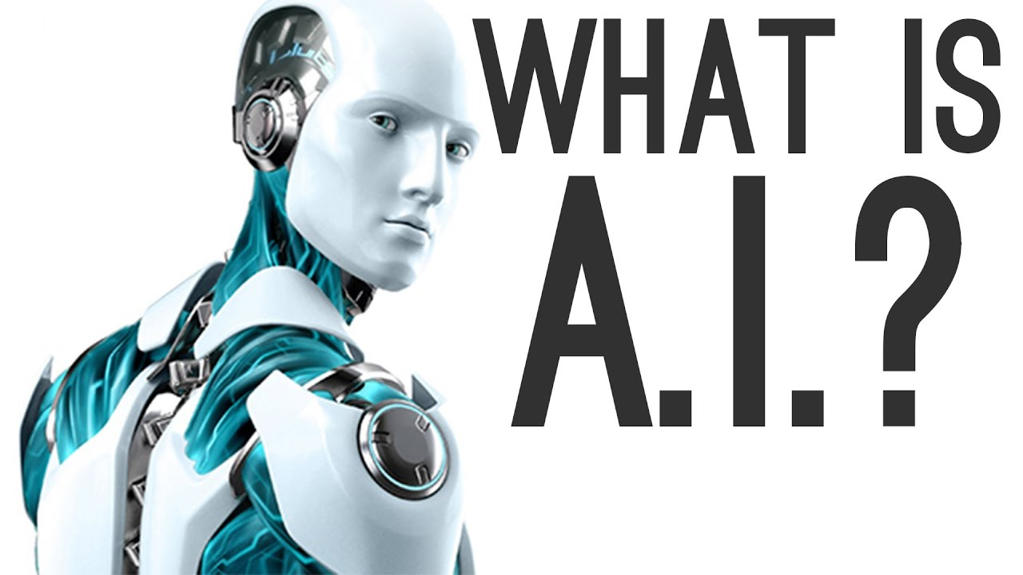
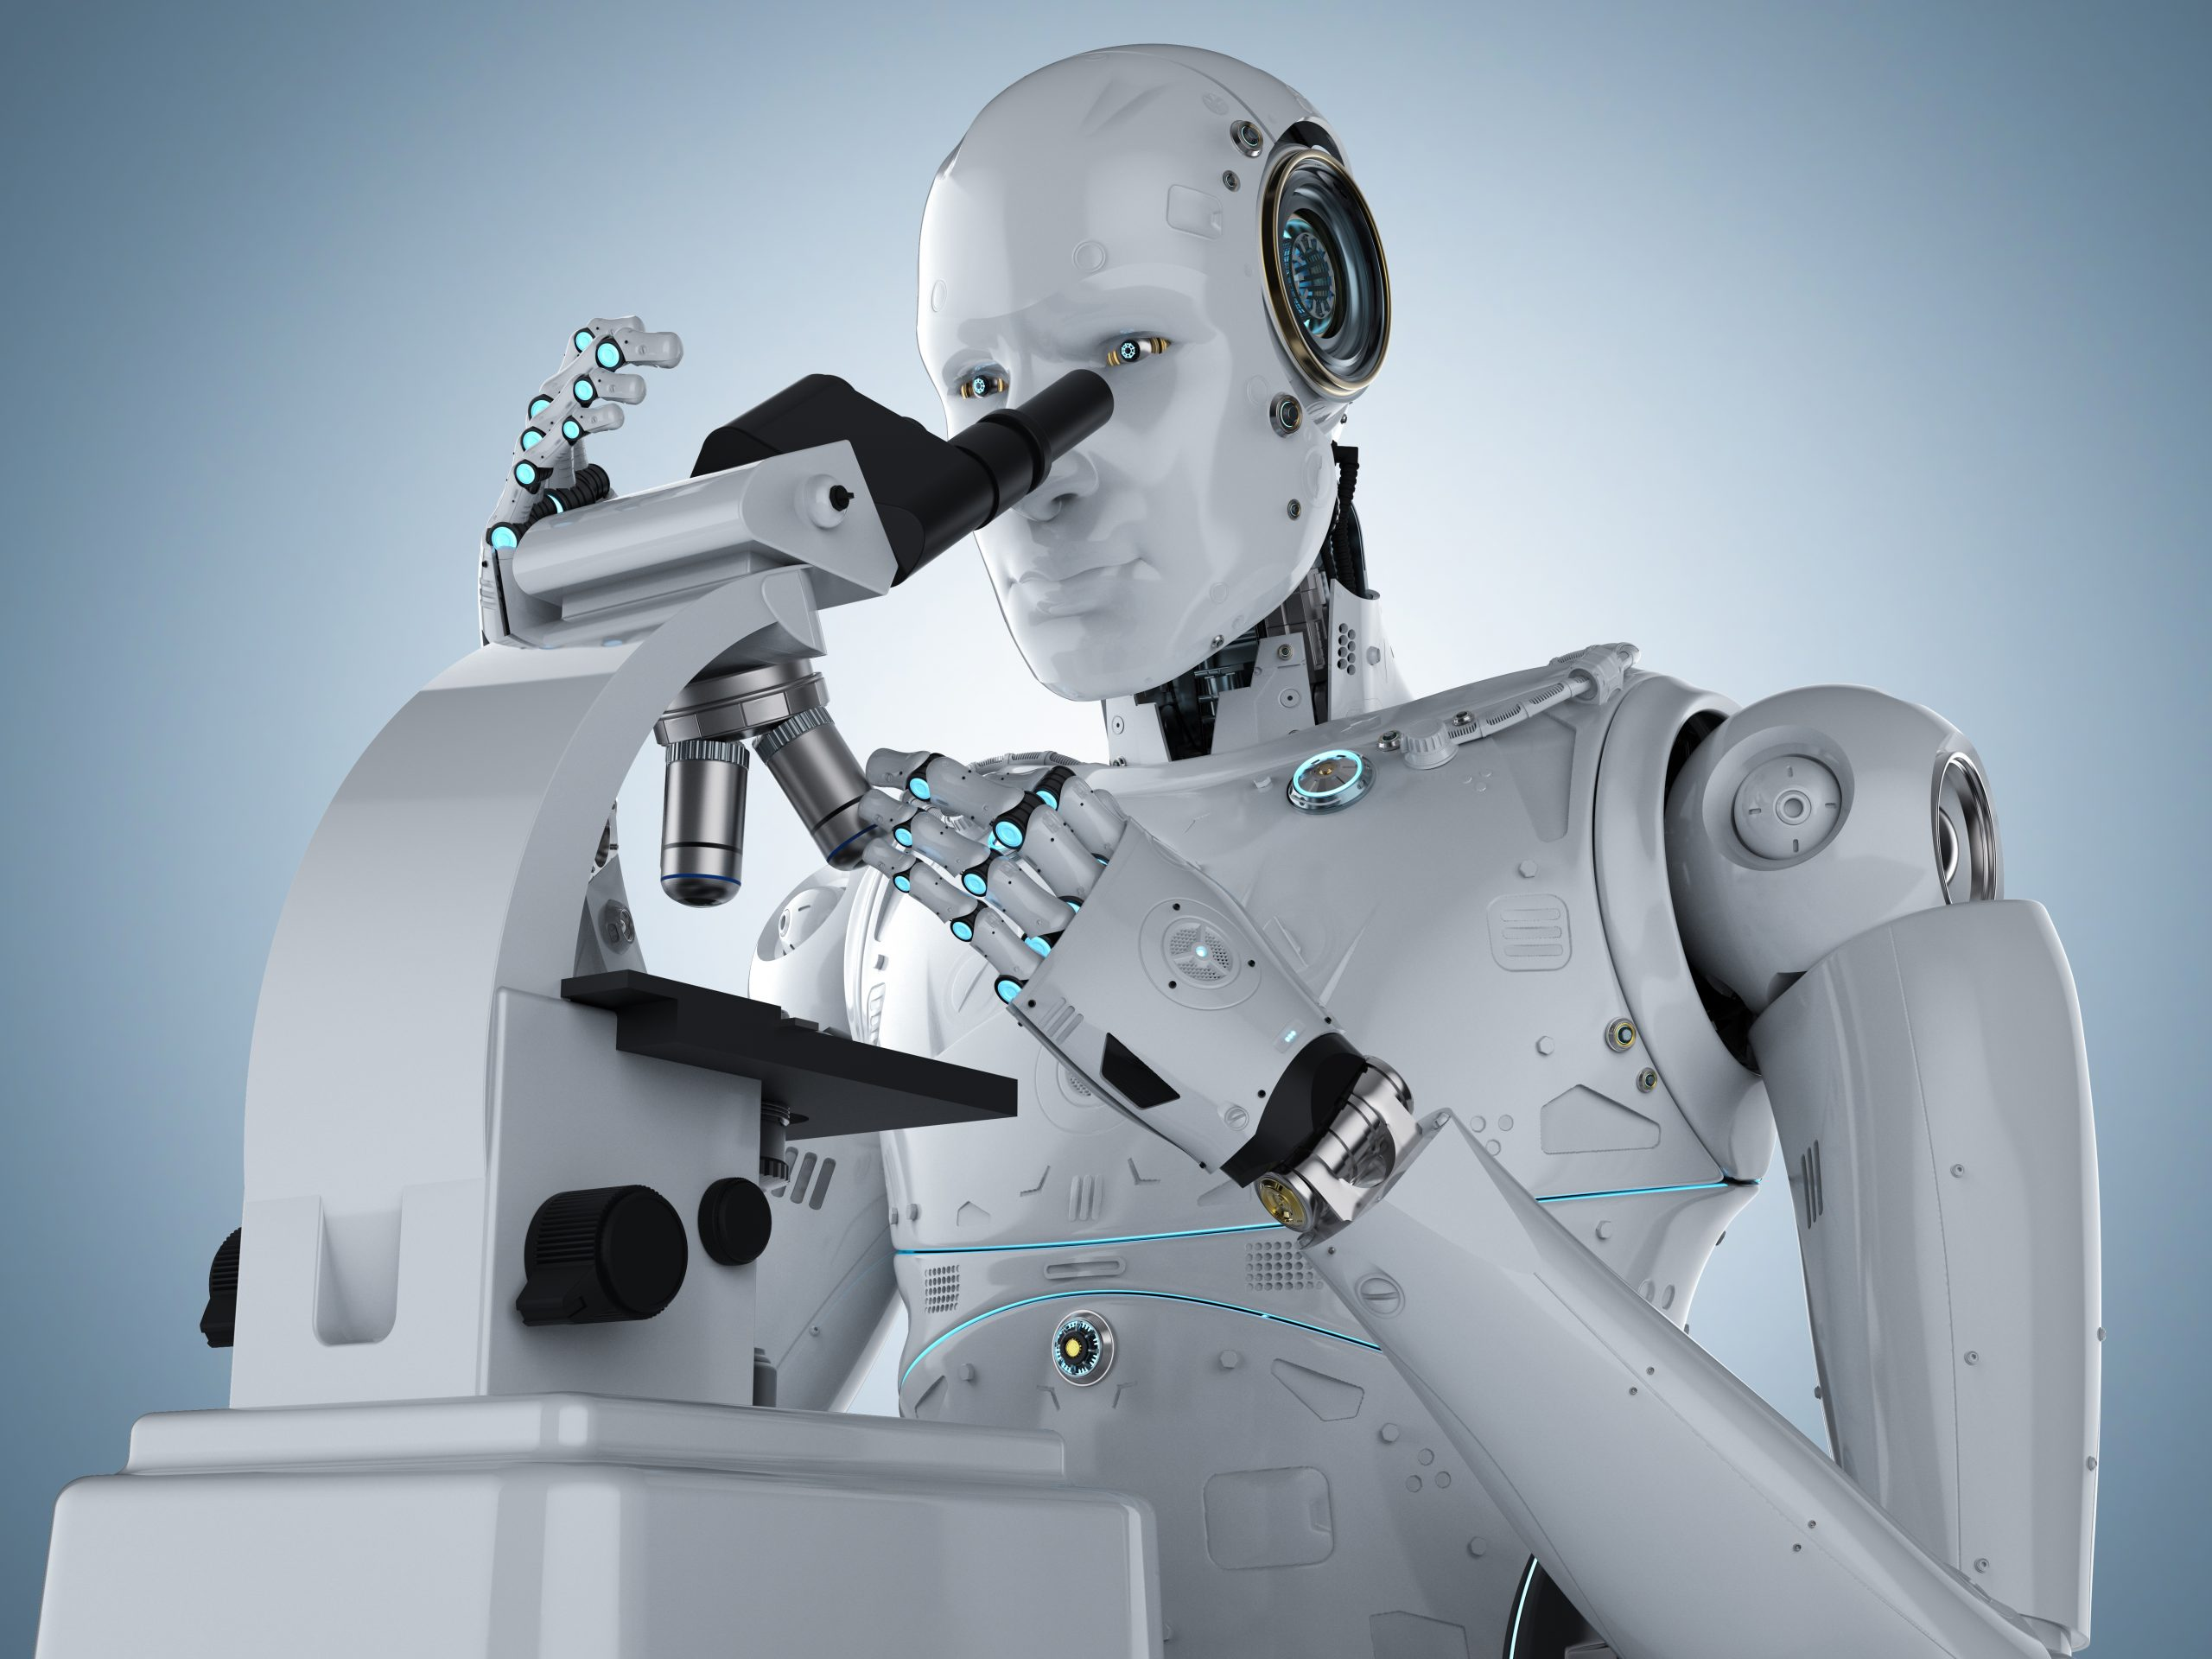
Notes:
https://towardsdatascience.com/advantages-and-disadvantages-of-artificial-intelligence-182a5ef6588c
https://www.mjvinnovation.com/blog/benefits-of-data-science-for-your-business/

Slide 59
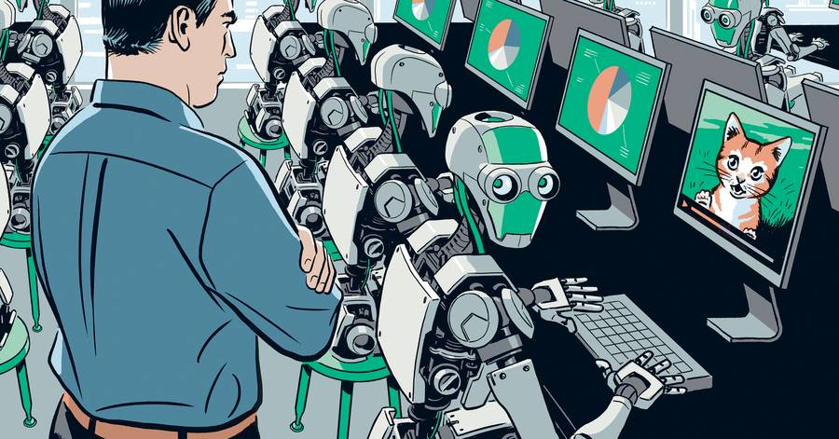
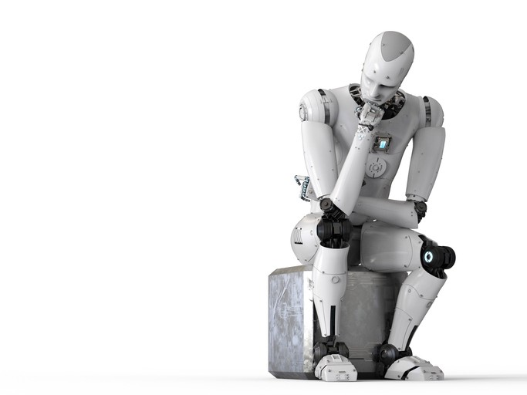
AI
Artificial intelligence (AI) is the concept of machines being able to learn, understand, and reason like humans.
Everything can be considered artificial intelligence if it involves a program doing something that we would normally think would rely on the intelligence of a human.
Notes:
John McCarthy invented the term Artificial Intelligence in the year 1950

Slide 60
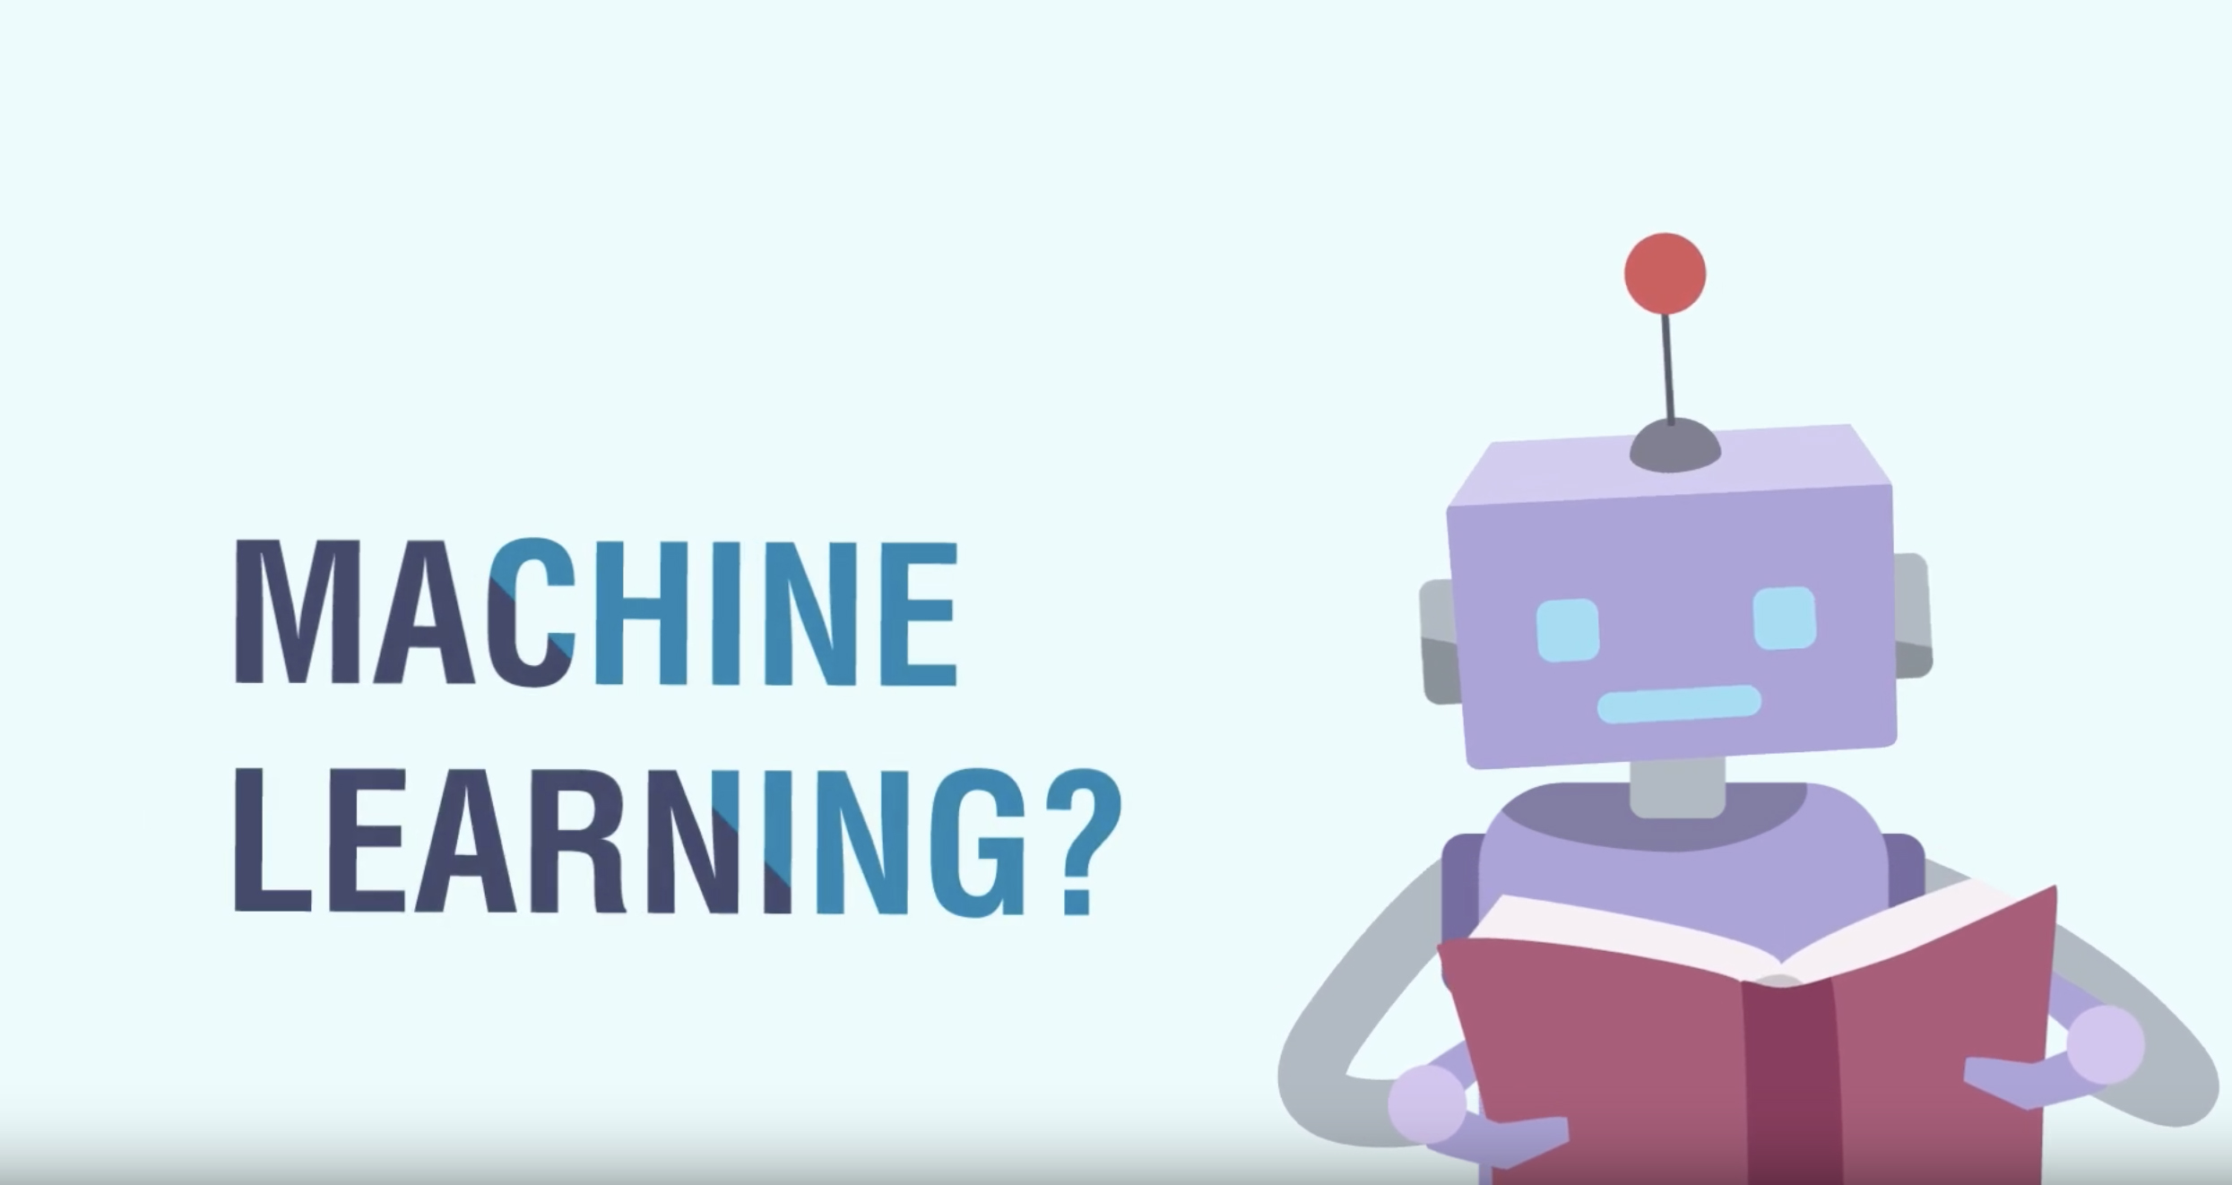
Notes:
https://towardsdatascience.com/advantages-and-disadvantages-of-artificial-intelligence-182a5ef6588c
https://www.mjvinnovation.com/blog/benefits-of-data-science-for-your-business/

Slide 61

Notes:
https://towardsdatascience.com/advantages-and-disadvantages-of-artificial-intelligence-182a5ef6588c
https://www.mjvinnovation.com/blog/benefits-of-data-science-for-your-business/

Slide 62
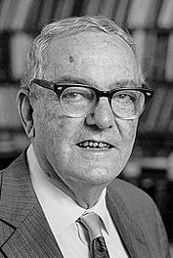
Machine Learning
Herbert Alexander Simon: “Learning is any process by which a system improves performance from experience.”
“Machine Learning is concerned with computer programs that automatically improve their performance through experience. It gives computers the ability to learn without being explicitly programmed“
Herbert Simon
Turing Award 1975
Nobel Prize in Economics 1978
Notes:
John McCarthy invented the term Artificial Intelligence in the year 1950

Slide 63

The concept of learning in a ML system
Learning = Improving with experience at some task
Improve over task T,
With respect to performance measure, P
Based on experience, E.
Notes:
John McCarthy invented the term Artificial Intelligence in the year 1950

Slide 64
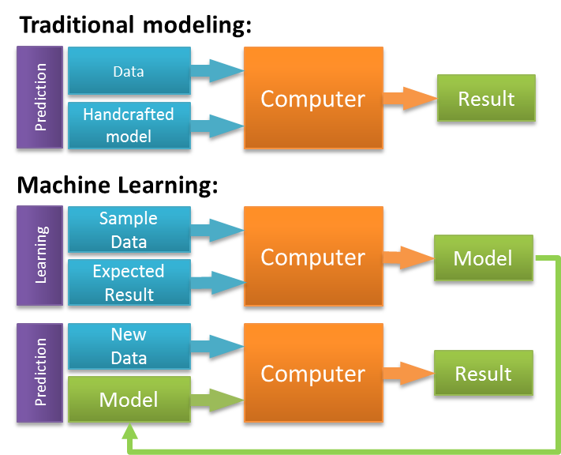
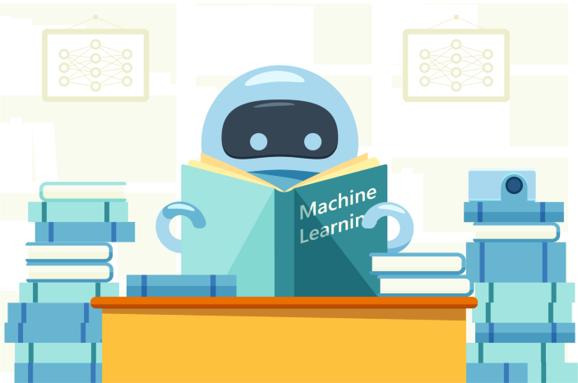
Notes:
n the first type of traditional prediction model, the input data set along with statistical assumptions and calculations determine the prediction algorithm. The input data set is analyzed (or “fitted to the data”) using statistical techniques. The prediction algorithm that is the one best suited to describing the data as determined by the statistical analysis.
The second type of traditional prediction model uses an explicit set of rules (e.g., if X then Y) to transform the inputs into a prediction. Instead of the prediction algorithm being “discovered” through statistical calculations, these rules are usually ones that are known by experts in the prediction domain (e.g., the medical knowledge physicians have in diagnosing/predicting a disease).
In contrast to the traditional quant prediction models, machine learning prediction models are developed in two steps.
In the first step, a machine learning model is trained. In this training step the input data, the historical results associated with these inputs, and a training algorithm are used to iteratively arrive at the prediction algorithm.
At the end of the first step, the model is “trained” and is now ready to make predictions.
In the second step, the prediction step, the trained machine learning model uses the prediction algorithm arrived at in the training step to transform new inputs into predictions.

Slide 65
What is the difference between algorithm and model?
A model is a mathematical expression that transforms inputs into outputs.
The model by itself cannot be used to calculate a result.
To do so requires fixing the model’s parameter values.
In traditional approaches, the parameter values are fixed based on statistical calculations.
In machine learning, the parameter values are fixed in the process of training the model.
Without its parameter values specified, a model is a structure, a shell, a high-level directive for transforming inputs into outputs.
With the parameter values specified, the model can be used to generate specific predictions.
Notes:
John McCarthy invented the term Artificial Intelligence in the year 1950

Slide 66
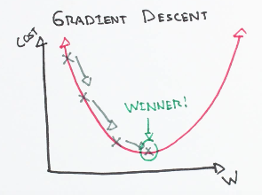
What is the difference between algorithm and model?
An algorithm is a recipe — a clearly defined step by step by step process — for turning a set of inputs into an output.
A prediction algorithm is the specific mathematical expression that results once the parameter values of the model are fixed.
In machine learning these parameter values are fixed during the iterative training process which itself proceeds by using an algorithm.
The most common of these training algorithms is called gradient descent.
Notes:
John McCarthy invented the term Artificial Intelligence in the year 1950

Slide 67
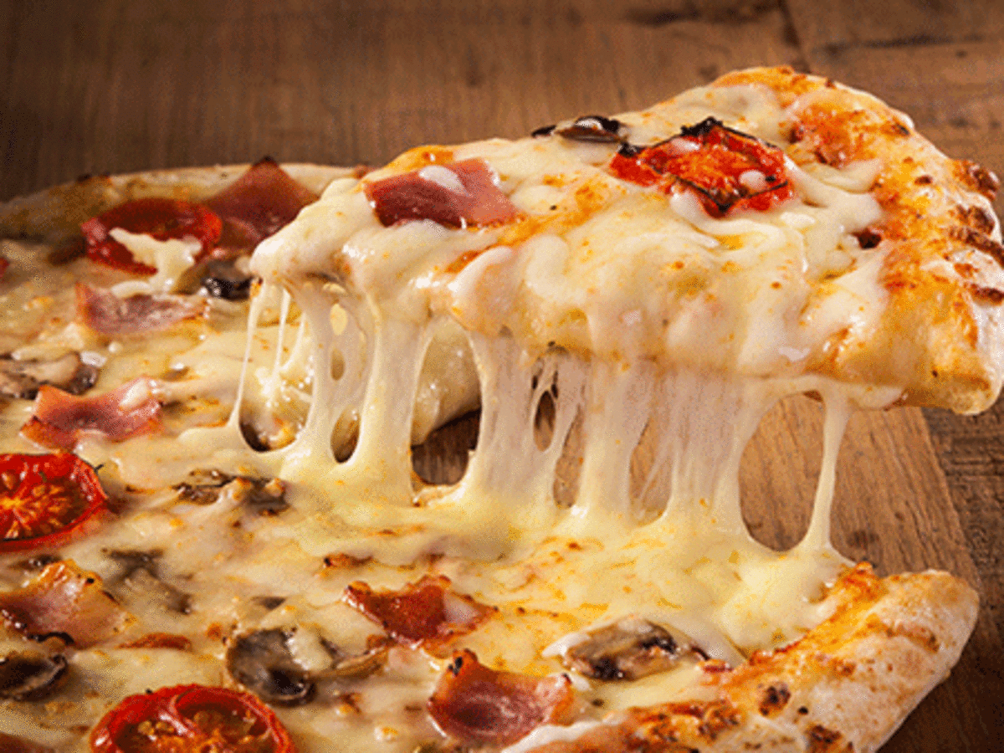
Intuitive demonstration
Let's imagine that we want to make a pizza.
We have
the ingredients and
the recipe
They both will be our inputs.
We follow the recipe and by following the correct sequence of steps, we end up with a ready-to-eat pizza.
This is traditional programming.
To get the right result we need the recipe.
We can write it ourselves or ask mom to write it for us.
Notes:
https://luminousmen.com/post/machine-learning-types/

Slide 68
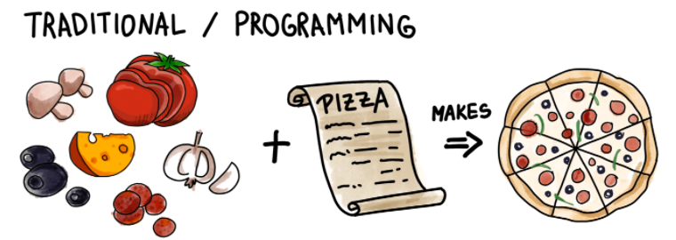
Intuitive demonstration
Notes:
https://luminousmen.com/post/machine-learning-types/

Slide 69
Intuitive demonstration
With machine learning, it's a little bit different
we don't know the recipe, we don't want to write or don't know it, but we want the pizza nonetheless.
We have a bunch of ingredients and some idea of pizza.
We have no idea how to make it, but we can invite our friends over and see from their feedback that what we've made is close to the kind of pizza we want, and maybe even delicious pizza!
As we continue to analyze pizza "metrics" over a period of time to determine what factors influenced the look, taste, and quality of the end result.
At some point, we eventually come to what our friends mean by real pizza. We write down the sequence of steps into the recipe.
Our algorithm is ready!
Notes:
https://luminousmen.com/post/machine-learning-types/

Slide 70
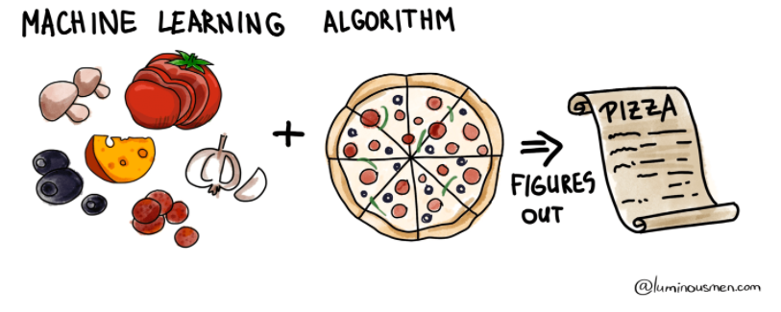
Intuitive demonstration
Notes:
https://luminousmen.com/post/machine-learning-types/

Slide 71
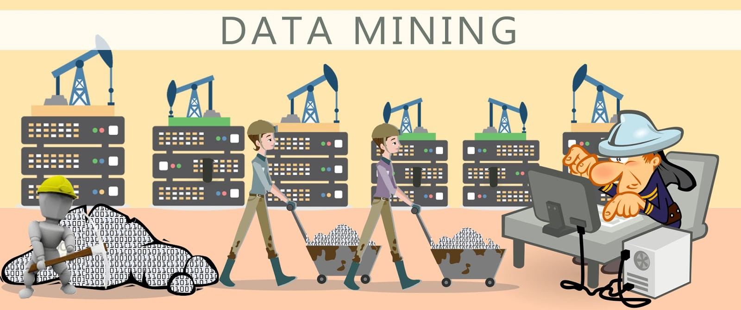
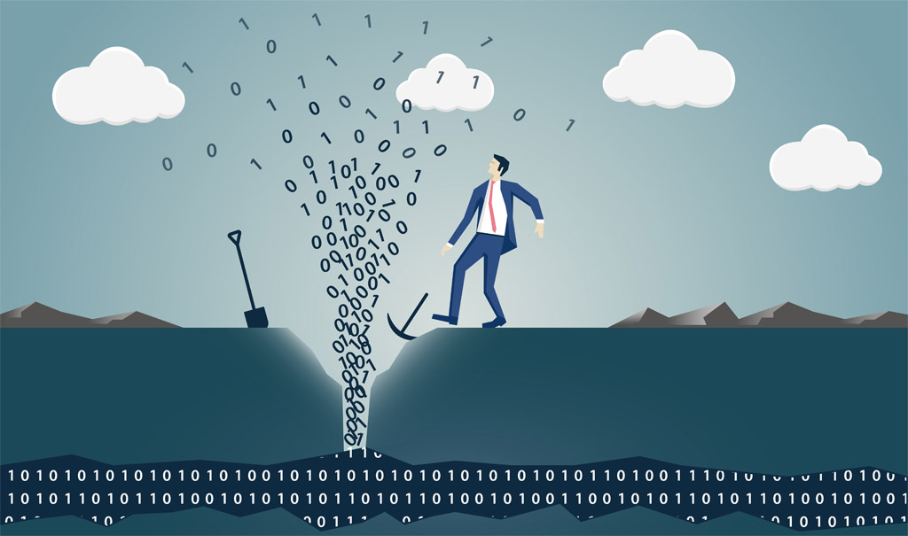
Notes:
https://luminousmen.com/post/machine-learning-types/

Slide 72
Data Mining
In data mining, the data is stored electronically and the search is automated—or at least augmented—by computer.
Even this is not particularly new.
Economists, statisticians, forecasters, and communication engineers have long worked with the idea that patterns in data can be sought automatically, identified, validated, and used for prediction.
What is new is the staggering increase in opportunities for finding patterns in data.
The unbridled growth of databases in recent years, databases for such everyday activities as customer choices, brings data mining to the forefront of new business technologies.
Notes:
https://luminousmen.com/post/machine-learning-types/

Slide 73

Data Mining
As the flood of data swells and machines that can undertake the searching become commonplace, the opportunities for data mining increase.
As the world grows in complexity, overwhelming us with the data it generates, data mining becomes our only hope for elucidating hidden patterns.
Intelligently analyzed data is a valuable resource.
It can lead to new insights, and, in commercial settings, to competitive advantages
Notes:
https://luminousmen.com/post/machine-learning-types/

Slide 74

Data Mining
Data mining is about solving problems by analyzing data already present in databases.
Discover new knowledge from large databases
Notes:
https://luminousmen.com/post/machine-learning-types/

Slide 75

Data Mining
Let’s focus on the problem of fickle customer loyalty in a highly competitive marketplace.
A database of customer choices, along with customer profiles, holds the key to this problem.
Patterns of behavior of former customers can be analyzed to identify distinguishing characteristics of those likely to switch products and those likely to remain loyal.
Once such characteristics are found, they can be put to work to identify present customers who are likely to jump ship.
This group can be targeted for special treatment, treatment too costly to apply to the customer base as a whole.
Notes:
https://luminousmen.com/post/machine-learning-types/

Slide 76

Notes:
https://luminousmen.com/post/machine-learning-types/

Slide 77

Data Science
Data science is an interdisciplinary field that uses scientific methods, processes, algorithms and systems to extract knowledge and insights from structured and unstructured data, and apply knowledge and actionable insights from data across a broad range of application domains.
Data science is related to data mining, machine learning and big data.
Notes:
https://luminousmen.com/post/machine-learning-types/

Slide 78

Notes:
https://luminousmen.com/post/machine-learning-types/

Slide 79
Big Data
“Big data is high-volume, high-velocity and high-variety information assets that demand cost-effective, innovative forms of information processing for enhanced insight and decision making.” (Gartner IT Glossary)
"Big data is a term for datasets that are so large or complex that traditional data processing applications are inadequate to deal with them" (Wikipedia)
“Big data is a term that describes large volumes of high velocity, complex and variable data that require advanced techniques and technologies to enable the capture, storage, distribution, management, and analysis of the information.” (Tech America Foundation's Federal Big Data Commission)
"Big data is like teenage sex: everyone talks about it, nobody really knows how to do it, everyone thinks everyone else is doing it, so everyone claims they are doing it..." (Dan Ariely)
Notes:
https://luminousmen.com/post/machine-learning-types/

Slide 80
Big Data
Big data was originally associated with three key concepts:
volume,
variety, and
velocity.
Other concepts later attributed with big data are
veracity (i.e., how much noise is in the data) and
value
“Big data is high-volume, high-velocity and/or high-variety information assets that demand cost-effective, innovative forms of information processing that enable enhanced insight, decision making, and process automation.” (Gartner)
Notes:
https://luminousmen.com/post/machine-learning-types/

Slide 81
Big Data
Notes:
https://luminousmen.com/post/machine-learning-types/

Slide 82

Characteristics of Big Data
Notes:
https://luminousmen.com/post/machine-learning-types/

Slide 83

Big Data
Data with many rows offer greater statistical power, while data with higher complexity (more attributes or columns) may lead to a higher false discovery rate.
Big data challenges include
capturing data,
data storage,
data analysis,
search,
sharing,
transfer,
visualization,
querying,
updating,
information privacy and
data source.
Notes:
https://luminousmen.com/post/machine-learning-types/

Slide 84

The Big Data Problem
Additional definition:
Data is too large to fit a single machine and model training requires learning from the entire dataset
It is not a big data problem if:
Moderate sample is sufficient
The problem can be converted to many independent “small” data problems.
Notes:
https://luminousmen.com/post/machine-learning-types/

Slide 85

Big Data and parallel processing
Above 1M instances, one should consider using parallel processing (such as MapReduce)
Above 10M instances, one must use parallel processing (not necessarily distributed)
Notes:
https://luminousmen.com/post/machine-learning-types/

Slide 86

Data everywhere
Opportunities
Abundant training examples
Richer context from users and hyperlinks
Challenges
“Dirtier” data
Efficient algorithms
Scalability (with reasonable cost)
Notes:
William E. Deming

Slide 87

Bigger = Smarter?
Yes!
discover the long tail and corner cases
machine learning works much better
Because we can
all data is digitally born
storage capacity is increasing
counting is embarrassingly parallel
But!
with enough data you can prove anything
still need humans to ask right questions
data grows faster than energy on chip
Notes:
William E. Deming

Slide 88


Is Big Data a big problem?
Challenges:
Storage
Processing
Learning
Notes:
William E. Deming

Slide 89
Example: Big Data at Netflix
Big Data at Netflix:
167 million users
160+ millions hours of video watched each day
4000 different devices
700+ billion events a day
60 peta bytes of data
Notes:
William E. Deming

Slide 90
Example: Big Data at Netflix
Some of Netflix data related challenges:
Building Big Data Infrastructure
Personal recommendation of movies
Creating Data Visualization Tools
Improving Marketing Effectiveness
Creating video previews
Minimize the playback startup time

Slide 91

Deep Learning
Deep learning is part of a broader family of machine learning methods based on artificial neural networks
Deep learning architectures have been applied to fields including
computer vision,
speech recognition,
natural language processing,
audio recognition,
social network filtering,
machine translation,
bioinformatics,
drug design,
medical image analysis,
material inspection and
board game programs

Slide 92

Deep Learning
They have produced results comparable to and in some cases surpassing human expert performance

Slide 93

Deep Learning

Slide 94

Buzzword explanation
Notes:
(AI) is intelligence demonstrated by machines, as opposed to the natural intelligence displayed by humans or animals
Machine learning (ML) is the study of computer algorithms that improve automatically through experience and by the use of data

Slide 95

Notes:
William E. Deming

